Slide 1
MVC Forms
IN712 OOSD 2017
Session 11.2
Notes:
With design patterns, we saw standardised, efficient architecture for solving specific types of programming problems.
In these cases, the design pattern was a component of a larger architecture.
But there are also patterns that describe complete architectures.
The generic 3-tiered architecture is one that you are familiar with; the “manager class” is another.
We are now going to spend some time looking at a large and important architectural pattern – Model-View-Controller. MVC is a specific type of 3-tiered architecture that is very well suited to large distributed (i.e. cloud-based) enterprise systems.
Many modern IDEs support MVC – e.g. Ruby, and Yii for PHP. We are going to use .NETs MVC paradigm for web sites, because this will allow us to continue writing C# (along with HMTL and CSS) and it is the foundation of most modern ASP.NET web sites. (There is an older architecture called Web Forms, that is easier to build, but is slow on the browser, and doesn’t scale well.)
Since we are switching to a web execution environment, we’ll quickly review the process model, for those of you who aren’t currently taking Web3.

Slide 2
Passing Data to a Controller - 1
In the URL
server/Controller/Action?Parameters
The “Parameters” element is built like an HTML query string.
?name_{i}=value_{i}&name_{j}=value_{j}….
Notes:
So, essentially, a GET-style query string
IN practice, this complex URL is built and invoked from elsewhere in the application, for example, from a link
Let’s look at an example…

Slide 3
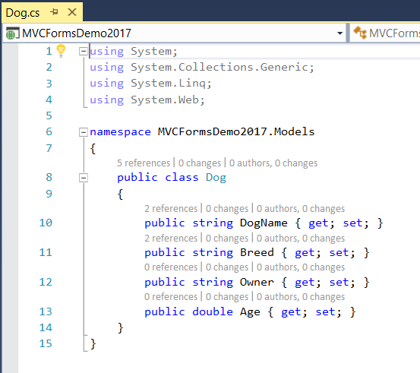
Model

Slide 4
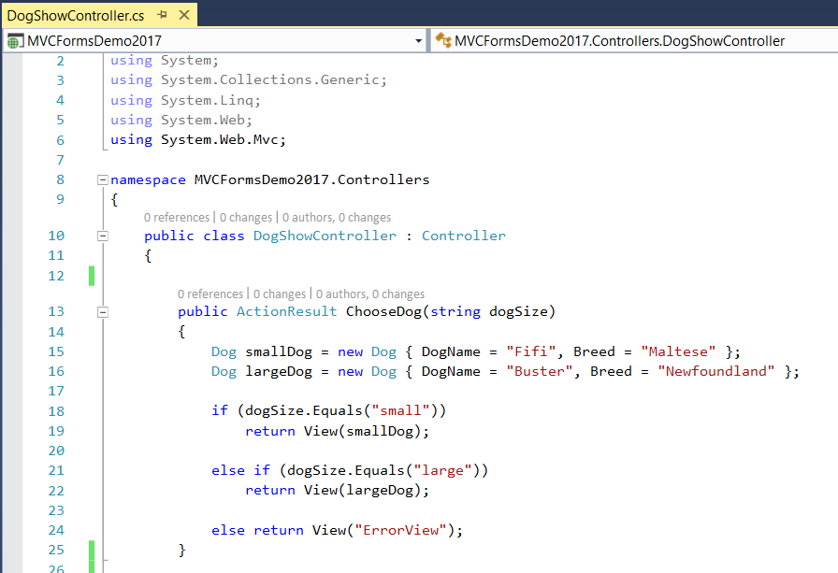
Example
Notes:
We’ll add a new, paramaterised ActionResult method to the DogShow controller.
We will see how to pass the parameter “string dogSize” in using a query string.
This method would be, perhaps, for searching our database for dogs of a particular size.
For purposes of example, we are going to stub out the “fetch from the database” part with hard coding, and just make a small dog and a large dog here in the method. We will display the dog that matches the input ‘search’ string.
Here we see an alternative syntax for creating instances of classes in C# without a constructor call.
We have a default view (that will of course be named ChooseDog.cshtml) and an alternative view (that will be named ErrorView.cshtml)
How will we create these Views? => Right-click in this method and select Add View
Let’s look at them…

Slide 5
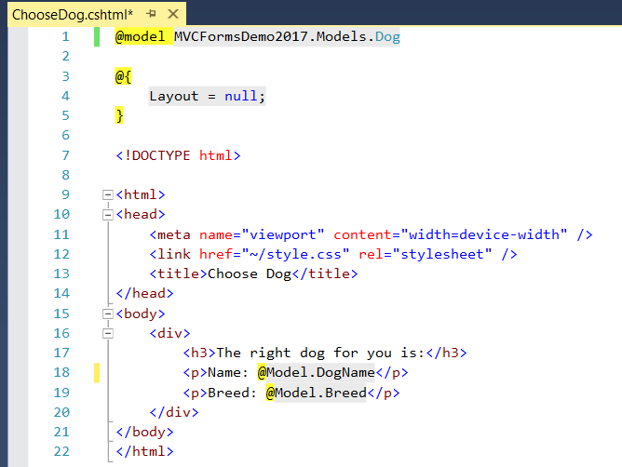
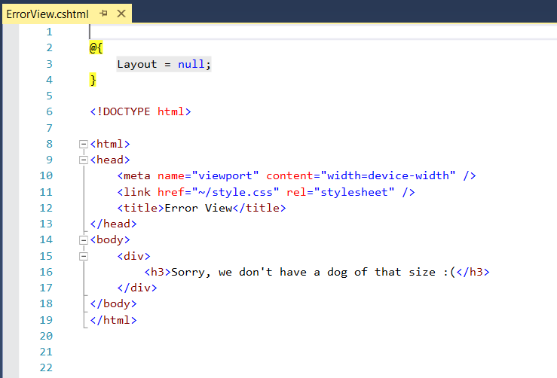
Example
Notes:
Note that ChooseDog is a strongly-typed view; ErrorView is not
ChooseDog prints the name and breed of the Dog it gets from the Controller
ErrorView gives feedback

Slide 6
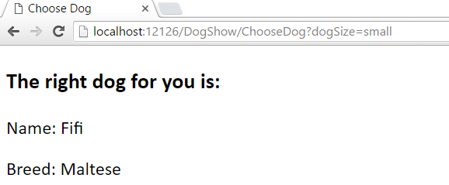
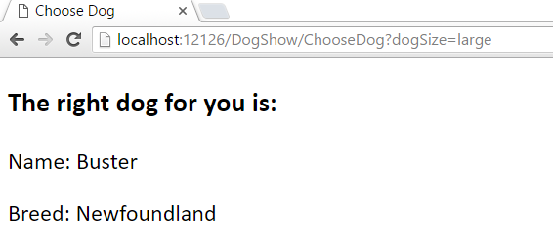
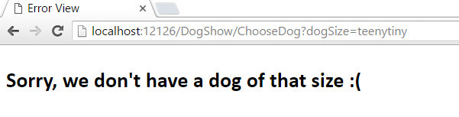
Example
Notes:
Here we pass the value of the dogSize parameter of the action method ChooseDog (belonging to the controller Dog) in as a query string.
In this example, we are just hard-coding the URL into the browser window opened by visual studio.
IRL, you would have the URL as a link on another page (managed by another controller).
Note the URL in each case. The key “dogSize” matches the name of the parameter of the ChooseDog method. The value assigned is what is passed into the method.
It can be a little hard to remember exactly what happens here – there’s a lot of work done between the URL and the page it displays, compared to an ordinary “give me this HTML page” URL.
Let’s review:
Remember that URLs in MVC are method calls.
So that first one says “Go to the Controller called DogShowController, call its method called ChooseDog, that method has a parameter called dogSize, pass in the value “small”.
The ChooseDog method is then executed. You remember that it makes two dogs and, if dogSize == small, it renders the default view passing in the small dog.
You will recall that the View pulls the name and breed fields from its input object and puts them in the HTML.
The result is as you see.
You may be wondering how you could code those URLs.
You wouldn’t actually type “localhost:2526” anywhere. That port number changes every time you restart Visual Studio.
Fortunately, MVC3 views “the server I’m running on” as part of the file structure of the project.
So, you can express your URLs like this…

Slide 7
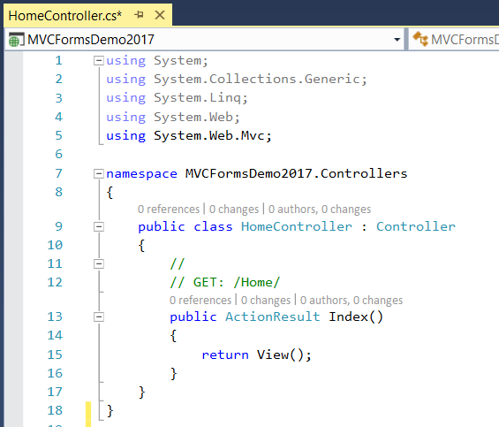
Example
Notes:
We decide to add a home page to our web site. We create HomeController, like this...
Then we write a View for the Index ActionResult method. That View is called.....? => Index

Slide 8
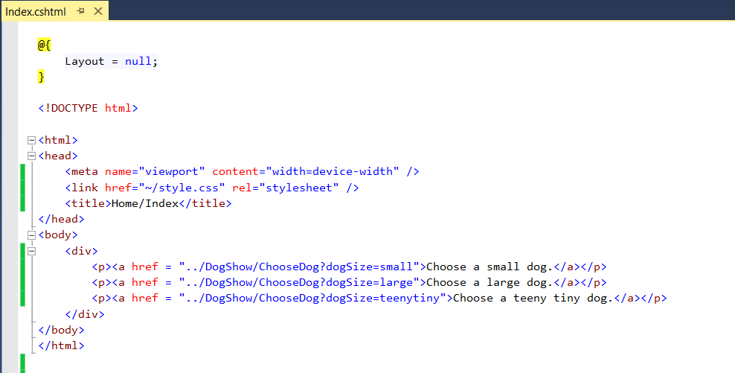
Example
Notes:
We can provide links like this...
Note that I have changed the title to make it clearer what page I am on. In a big MVC project, you may have several files called Index.cshtml (can you see why?). It can get a little confusing during development when you have them open to edit.
There are the URLs. They are exactly like what we typed into the browser, except for the localHost part.
The ../ is ordinary UNIX “up to the containing folder”. MVC3 interprets that as “the server”
Here’s what it looks like when I go to the Home/Index URL..

Slide 9
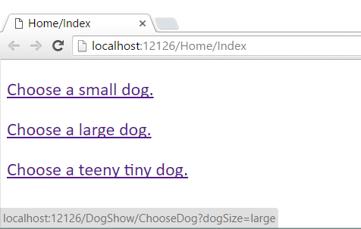

Example
Notes:
By hovering over a link (in this case, the large dog link) you see the URL. As you see, it inserts the correct server address.
When I click on these links, I see exactly the same pages as when I hard-coded the GET into the browser window.

Slide 10
Passing Data to the Controller - 2
With a self-processing form
Create an appropriate controller
Create two versions of an Action Method to manage the Form’s presentation.
Give one version attribute [HttpGet].
This version returns a View that displays the initial Form.
Give the other version attribute [HttpPost].
This version accepts the user data as input parameters and returns a View that displays what the user sees after submit.
Notes:
More commonly, we will pass user data to the controller from a form.
In MVC, we usually use self-processing forms. That is, the controller has code both to present the form and to process the data from the form.
It works like this. It’s a little confusing at first, so we will walk through it slowly…
The two versions of the Action Method have the same name, but are marked differently using attributes (header commenty things in []).
Let’s look at an example….

Slide 11
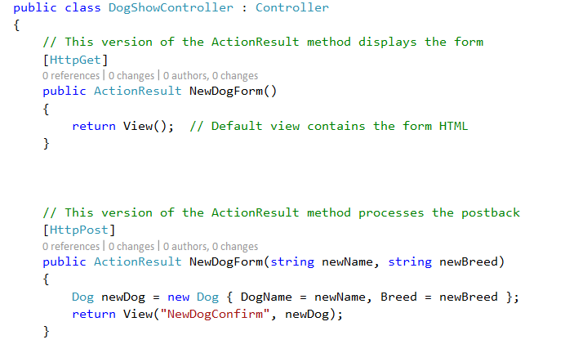
Example
Notes:
I’ve added these two methods to my DogShow controller class. Together they will implement a self-processing form that creates a new dog instance based on user-supplied data. (IRL, we would perhaps add this new dog to our database).
The HttpGet method returns the default view, Views/DogShow/NewDogForm. That View is going to be a simple form that allows the user to enter two string values for name and breed.
What View will I create this form on? => DogShow/NewDogForm, the default for this action method,
The HttpPost method accepts the two strings as parameters, uses those values to create a dog instance, and then passes that dog to a new View called “NewDogConfirm”.
Let’s look at those two Views…

Slide 12
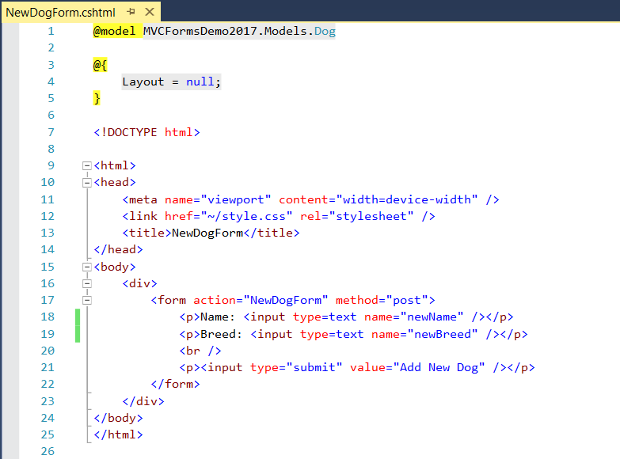
Example
Notes:
The View for the initial form – NewDogForm (the default View for method NewDogForm())
We are posting back data, so we need an HTML <form>, as normal. It has action and method attributes, also as normal.
The form action, the name of the ActionResult method, makes this self-processing. Note we don’t put a file suffix on here, we want to *call the action method* so we construct the appropriate URL, which doesn’t have any file suffix information
(It can get a little confusing that you have NewDogForm, the name of the method and NewDogForm, the name of the View file. Because of ASP’s Convention rules, we just have to put up with that.)
We then have normal HTML input elements. Text boxes for user input and a normal submit button for form postback. (IRL we would have some CSS formatting to make these line up pretty.)
Note that the name attributes of the text fields match the parameters into the HttpPost action method version. This is essential. That is how the system will match up postback variables to method arguments in the controller.
(While this shows the general way of passing POST data, because the View is strongly typed, we have an alternative, which we will see later.)

Slide 13
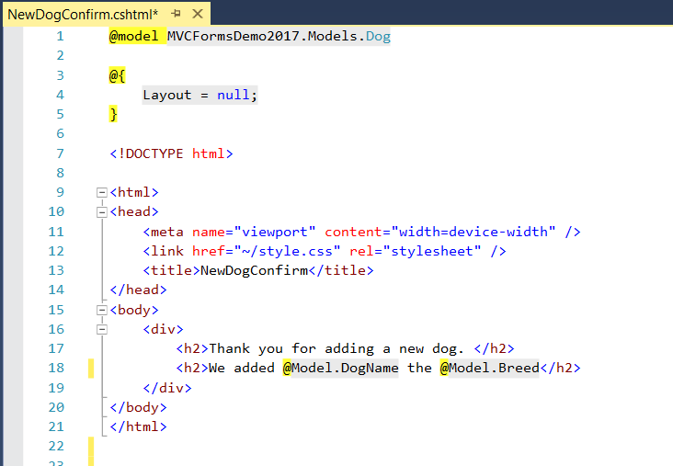
Example
Notes:
Here is the second View, NewDogConfirm.
The HttpPost version of our action method renders this one…
Review:
Accessing server/DogShow/NewDogForm calls the HttpGet version of the NewDogFrom method of Controller DogShow.
That method simply returns its default view – also called NewDogForm
That view contains the html for the Form
On submit, control is automatically transferred to the HttpPost version of method NewDogForm of Controller DogShow (because that’s the action attribute of the form).
The HttpPost version creates a Dog instance using the POST data, and passes it to this View.
What do we see on the screen?

Slide 14
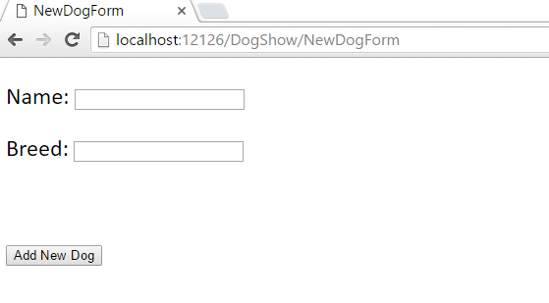
Example
Notes:
Initial View
Note the URL.
The user might get here from a link on a welcome or nav page (with its own controller).

Slide 15
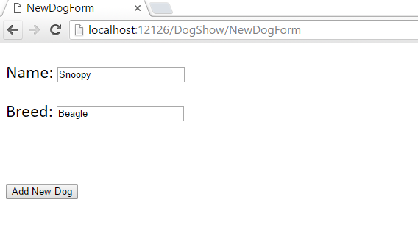
Example
Notes:
User types in values, then clicks submit….

Slide 16
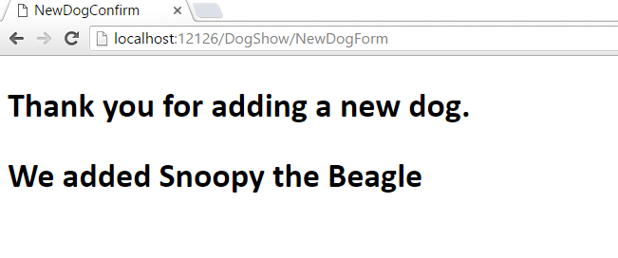
Example
Notes:
And see this after submitting.
Note that the HTML we are seeing is contained in NewDogConfirm.cshtml.
But look carefully at the URL. You don’t see NewDogConfirm.cshtml there. Because, as you recall, URL’s in ASP are method calls, not file paths.
We called the NewDogForm action method
It returned for us the NewDogConfirm view (you can see the title, and also, you know this is the HTML for that View).
Remember with this development model, the URL is the *action method* not the page the browser is rendering.
Can be a little confusing, so watch out for it.

Slide 17
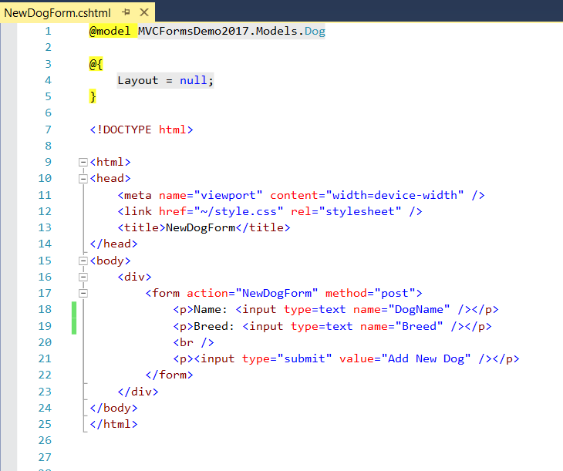
Using Strong Typing
Notes:
There is a more succinct approach for the step in the HttpPost method where you created the dog.
First, we change the form code (View DogShow/NewDogForm) a little bit. =>
Before the names of the text fields were newName and newBreed, matching the names of the input parameters to the HttpPost method
Now we’ve changed the textbox names to be the same as the field names of the Dog class.
It wouldn’t work to pass in parameters of this name, as you would be trying to say {Breed = Breed} when creating the Dog instance
But because the View is strongly typed, the system can create an entire new Dog instance for us automatically, assigning the fields based on the text field names, and pass that back to the controller.
So, we must change our [HttpPost] action method to this….

Slide 18
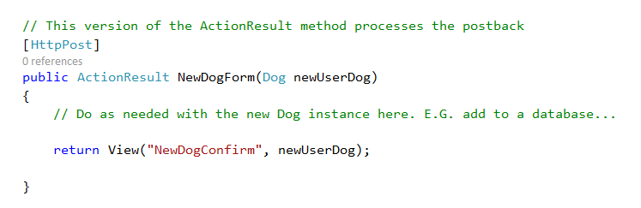
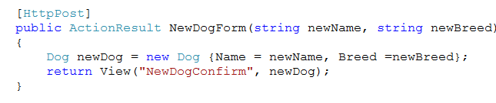
Using Strong Typing
Notes:
On the top, we just state that the method has an instance of the strongly typed type as a parameter.
We don’t have to create it. This signals to the system that on postback, it should create an instance, initialise it by looking to matching names in the POST data and pass it in to the action method.
The controller then passes it along to the strongly typed View NewDogConfirm, as before.
One note: To make this work, you must provide properties (those public capital letter {get;set;} things) for all the class fields, so the system can create the instance.
(The one on the bottom is the previous general passing example, for comparison.)

Slide 19
Practical

